Slide 1
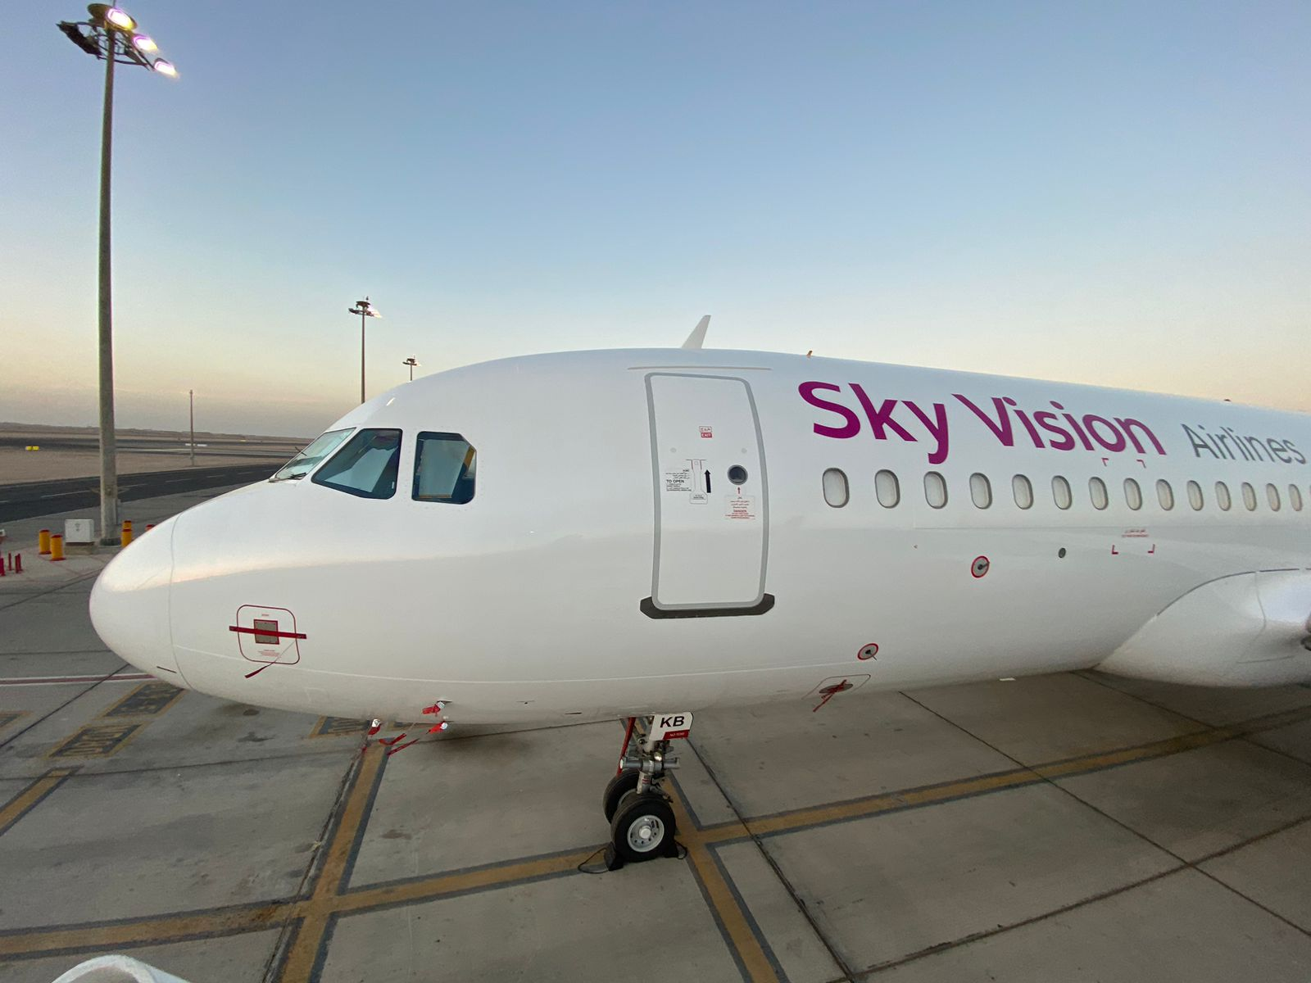
Introduction

Slide 2
Our Values
Our values are
Compliance with optimum safety and quality standards to assure sustainability of profitable operation.
People is the most valuable asset so investing in enhancing their knowledge skills and attitude through empowerment & full support from top management.
Leadership within all levels of Sky Vision Airlines is the corner pillar of Market Leadership.
Flexibility & Allocation of Optimum Resources leads to the Successful fast, Solid and Planned Paces.

Slide 3
Our Vision
Our Vision
Safety Operations.
Market Leadership.
Fast, Solid & Planned Expansion.
People Satisfaction.
Financial Strength.

Slide 4
Sky Vision Milestones
2022
AOC Holder
2022
AMO Certificate
2023
EU TCO
2024
2024
2024
DGR Certificate
UK TCO
ACC3

Slide 5
Sky Vision Outlines:
Sky Vision Airlines operates nonscheduled flights both domestically and internationally within EUR FIR, AFI FIR and MID-ASIA FIR
Sky Vision Airlines IATA two letter code is SE
Sky Vision Airlines ICAO three letter code is SVI
Sky Vision Airlines Fleet Reg. SU-SK..

Slide 6
Sky Vision Outlines:
Share Holders:
Mrs. Somaia AbdElkhalek Aly Mostafa
Mr. Amro Elsayed AbdElzaher Soliman
Investment Group:
Sky Vision Airlines is a part of investment group includes:
Goodies Egypt Bakery & Pastry Factory.
CHTAURA Frozen Foods Factory.
Kwanzo Balloon.
Middle East for Transportation and Logistics Company.

Slide 7
Type of Operation
Sky Vision Airlines operated under the privilege given by the ECAA in its
OPS. SPECS.
Sky Vision Operating domestic and international charter flights.
Sky Vision Airlines ACMI contract with another airlines.
Sky Vision Operating domestic and international Cargo charter flights

Slide 8
Sky Vision Current Active Fleet
A/C | Reg | MSN | Seats | Status | In Service | Owner
A320-232 | SU-SKB | 2204 | 180 | Active | Yes | Carlyle Aviation
A320-232 | SU-SKC | 2589 | 180 | Active | Yes | Carlyle Aviation
A320-232 | SU-SKE | 3618 | 180 | Active | Yes | Sky one F2Z
A/C | Reg | MSN | Load | Status | In Service | Owner
A320-232 P2F | SU-SKD | 2724 | 22 Tons | Active | Yes | Value
A321-231 P2F | SU-SKF | 2247 | 27 Tons | Active | Yes | Wilmington

Slide 9
Sky Vision Expansion Fleet Plan
Aircraft | Suspected Delivery
A330 | Jun 2025
A330 | Jun 2025

Slide 10
Key Operational Partners
Partner | Provision
Airbus | Technical Support
IAE
EGYPTAIR Training Academy | Training Support
EGYPTAIR Maintenance & Engineering (EGME) | Maintenance Support
JORAMCO
EGYPTAIR Cargo | Cargo Handling
Egyptian Aviation Services (EAS) | Ground Handling

Slide 11
Thank You

